Slide 1
Defensive Driving Motorcycles & Mobiles
OHS

Slide 2
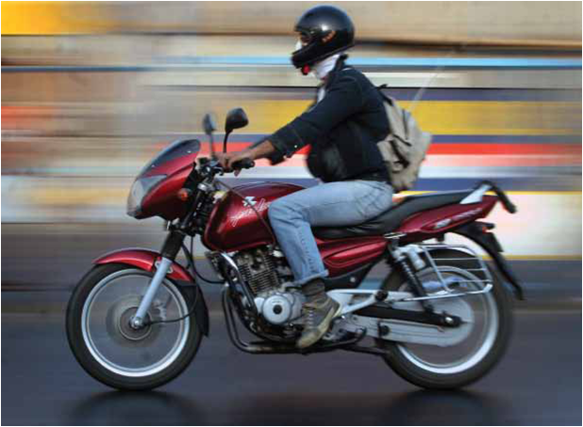
Driving is one of the key Risks in our work
Key Risks

Slide 3
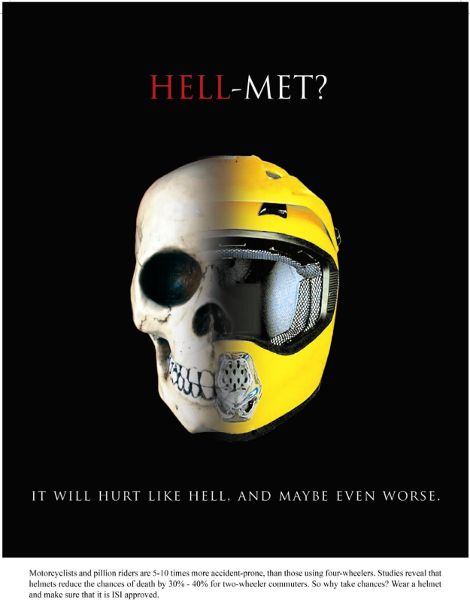

OHS Communication

Slide 4
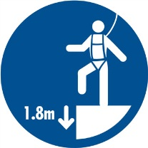
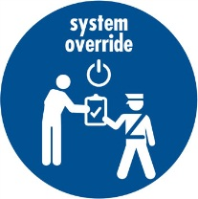
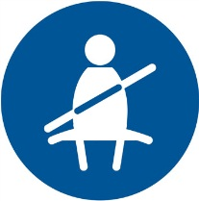


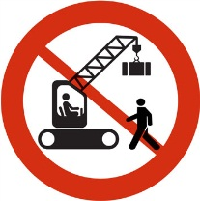
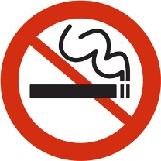
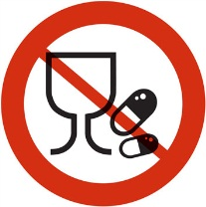



Life Saving Rules
Use Full Body Safety Harness with Double Lanyard, Helmet, Shoes & Maintain 3-Point Contact All The Time
Strictly Follow Ericsson OHS standards and instructions at all times
Verify & ensure isolation before work begins and use related PPEs
Wear your seat belt driving 4-Wheeler and Helmet while driving 2-Wheeler
Ericsson approved PPE to be worn at all times
Check Vehicle’s Roadworthiness and observe vehicle speed
Do not work under drop / exclusion zone
Do not smoke at Workplaces
No alcohol or drugs while working or driving
Do not use your phone and do not exceed speed limits

Slide 5
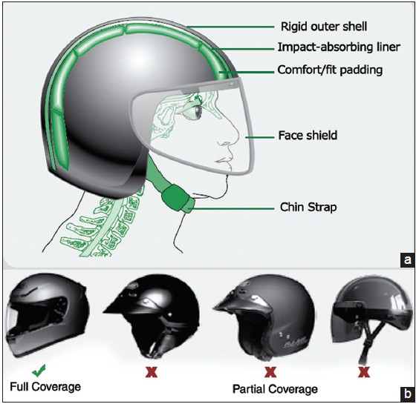
Motorcycle Safety
Always wear a helmet while riding
Ensure that both passengers are wearing Full Face ISI helmets
Use a good quality helmet. A thin or bad quality helmet can do more harm than good
Use Full face piece, ISI Helmet with chin strap
Do not take more than one passenger as pillion

Slide 6
Defensive Driving principles
Be more visible - Light color clothes are visible in hours of darkness or use reflective Jacket as provided.
Use stopping / turning indications while riding
Observe lane discipline
Ensure the head and tail light are in working condition
Rear view mirrors should be well maintained
Ensure license, identity card and ICE numbers are carried while riding
Ensure horns and brakes are in working condition.

Slide 7
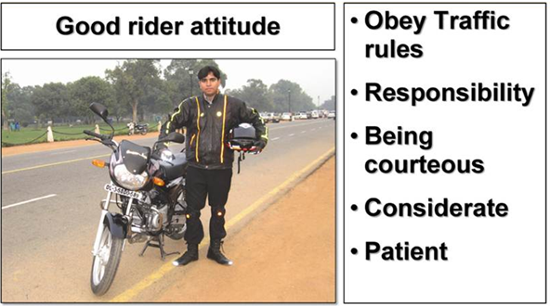
Safety Tips
Notes:
A rider can be called good only if he knows his responsibilities and is able to take them on. There are administrative and social responsibility on him.
He should prepare the vehicle well before riding and wear safety equipment so as to avoid breakdowns and injuries and remain comfortable during the journey.
Make it a habit of doing routine maintenance checks before every trip to enjoy trouble free riding.

Slide 8
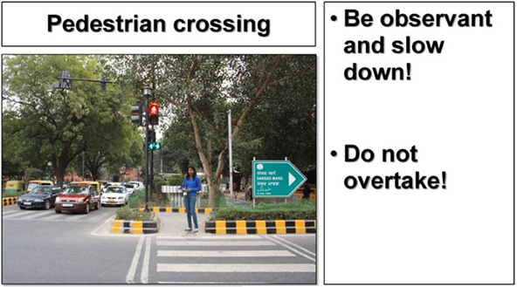
Safety Tips
Notes:
Pedestrians always have the right of way on crossings where signals are not functional, not installed or in the absence of a traffic controller. Here, always be particularly careful about cyclists and pedestrians as they are the most vulnerable road users!
Wherever a traffic signal is installed, pedestrians have the right of way only when they have a green signal or the instruction to cross.

Slide 9
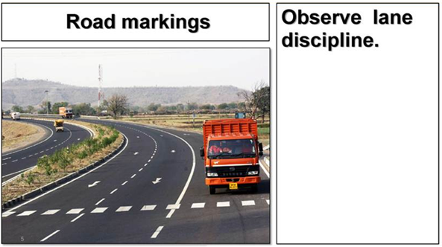
Safety Tips
Notes:
Road pavement markings
Road markings are painted on the roads, kerbs and dividers in the form of lines, patterns, words and colours. Some may be instruments or reflective signs attached to the road surface or kerb to guide the driver.
Special paints are generally used for road markings but other materials such as road studs, cat’s eyes and thermoplastic strips are also used to promote road safety and ensure smooth flow of traffic.
Sometimes, road markings are used to supplement or reinforce existing road signs and other devices:
A colour code may be used:
White - black to warn during day time and
Yellow - black to warn during night time.
The road markings are in addition to road signs, which give advance directions, information and guidelines about orders and warnings.

Slide 10
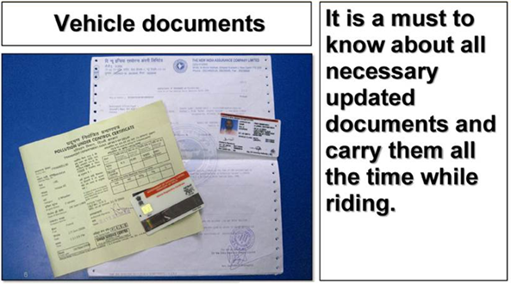
Safety Tips
Notes:
While driving, it is mandatory for the driver to always carry the following documents:
A valid driving licence
Vehicle registration certificate
Road tax certificate as applicable
Insurance certificate
Pollution under control certificate
Permit and vehicle fitness certificate (applicable only to transport and commercial vehicles)

Slide 11
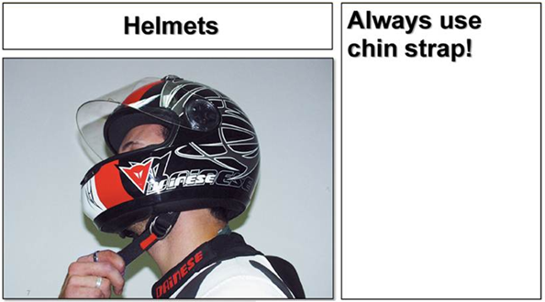
Safety Tips
Notes:
Helmets
Before you start your trip you must have all the safety equipment that can save your life or reduce injuries.
You should always wear an ISI mark helmet, to avoid serious head injuries.
Helmet should be fitted with proper eye and face protector and lock in the strap to adjust.
Do not forget to lock with the strap, otherwise it can drag or fall off the head in the event of an impact.
Size of helmet - should allow a sliding fit.
Paint or stick fluorescent material on the front and rear of helmet.
Helmet should have proper ventilation to avoid misting inside.

Slide 12
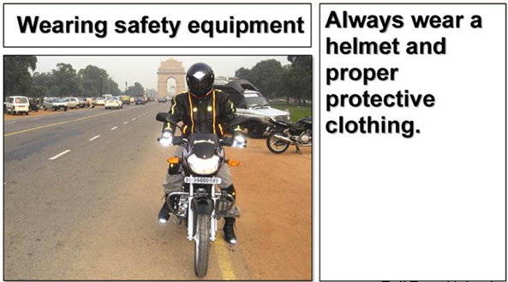
Safety Tips
Notes:
Wear snugly fitting jackets and trousers to avoid flapping and to have free movement.
Use clothes with fluorescent materials that makes you visible for other road users.
Use ankle length shoes which give protection to your ankles.
Wear knee and elbow guards which can save you from fractures and other injuries.
Wear riding gloves which protect hands from scratches and injuries in case of any crash or falling.

Slide 13
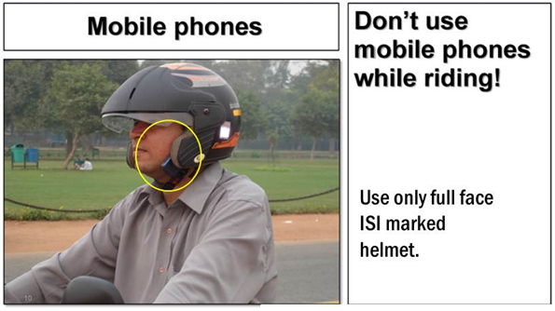
Safety Tips
Notes:
Pull up and stop at as safe place if you need to use the mobile phone.
Mobile phone use while driving is common, but widely considered dangerous. Due to the number of accidents that are related to cell phone use while driving, some jurisdictions have made the use of a cell phone while driving illegal.
As per rule 250 (A)(1) of Maharashtra Motor Vehicle Rules 1989, use of mobile phone is prohibited by driver while driving or riding a motor vehicle (including two wheelers).

Slide 14
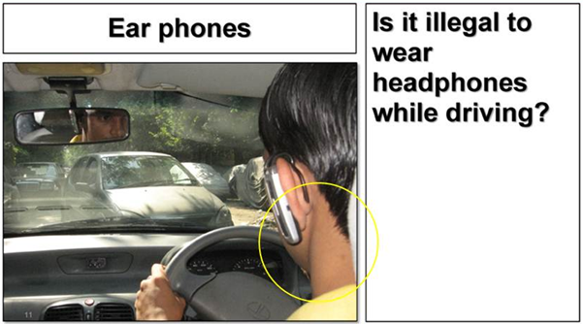
Safety Tips
Notes:
For safe driving you also need to hear the sound of other vehicles or any other sound. Good eye sight is required to be able to make out the colour of lights at signals, to read and identify all the signs and other traffic devices from an appropriate distance.
Driving while using a hands free cellular device is not safer than using a hand held cell phone. The increased cognitive workload involved in holding a conversation, not the use of hands, causes the increased risk.
If you are alone in the car, you shall switch off your mobile phone while driving any motor vehicle.(Section 250 (A)(2) of M.M.V.R.1989)

Slide 15
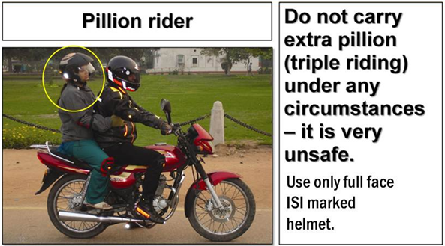
Safety Tips
Notes:
Motorbikes are constructed for the rider and maximum one pillion rider.
Make sure pillion rider is wearing all proper safety equipment like helmet with visor, proper clothing, ankle length shoes, knees and elbow guards etc. as worn by the rider.
Pillion should hold rider around the waist.
He should be able to keep balance with the rider.
Advice him to keep balance by leaning with you and positioning himself as per changing situations of road, curves and bends.
Pillion should keep legs and clothes away from muffler, drive chain or other moving parts.
Always warn your pillion about changes in riding styles or the situation ahead.
Don’t talk unnecessary with pillion rider.
Note:
Even a lady should sit astride, keeping legs across both sides resting on foot rests. A lady wearing Indian dress/sari should avoid her clothes flying around.

Slide 16
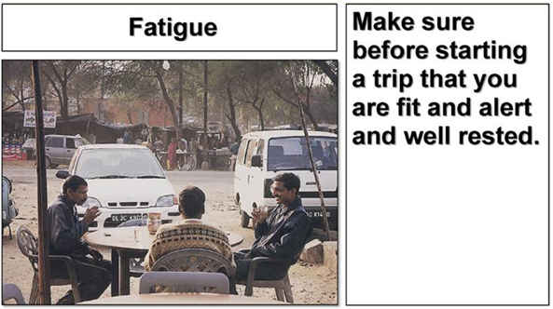
Safety Tips
Notes:
A motorcycle rider must be fresh and fit. Getting enough sleep (7 – 8 hours) is a must for safe riding. If not rested enough riding is affected adversely.
Fatigue occurs after long continuous hours of work, thus reducing efficiency. The remedy is to take a small break every two hours, freshen up and start again. It is not advisable to drive more than six hours a day.
Tiredness means a person is likely to fall asleep. This happens more often when drivers are about to reach their destination and they try to pull on and squeeze in the last leg of the journey. The remedy is to have a break with a power nap for at least 20 minutes.

Slide 17
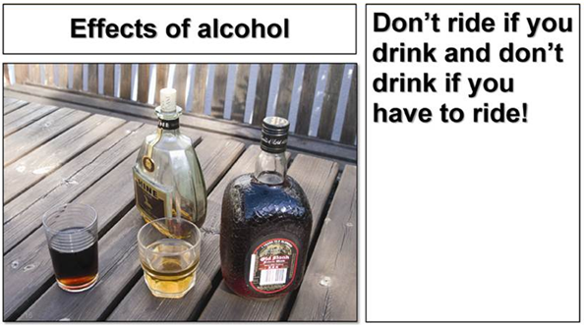
Safety Tips
Notes:
The legal limit for drinking and riding is below 30 mg of alcohol in every 100 ml of blood. It is a punishable offence to ride when you exceed the limit and are inebriated.
If a person is found riding or attempting to ride a motorcycle while under the influence of alcohol, he shall be liable:
Punishable for the first offence with an imprisonment for a term which may extend up to 6 months or a fine up to Rs. 2000/- or both.
For a subsequent offence committed within 3 years of the previous offence, with imprisonment which may extend up to 2 years or fine up to Rs. 3000/- or both.

Slide 18
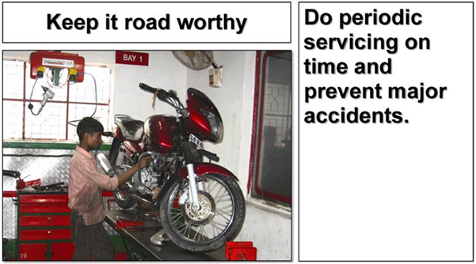
Safety Tips
Notes:
A motorcycle is less stable on the road because of its size and very little contact/traction with the road and needs frequent attention.
Check and re-check it before every ride and you must:
Do not forget the pre-starting checks.
Never leave any minor defect unattended.
Never overload the bike.

Slide 19
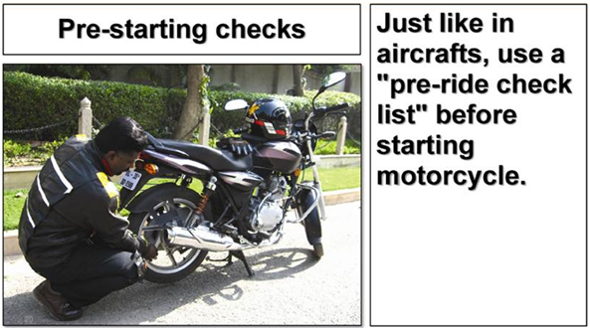
Safety Tips
Notes:
This list includes:
Tyres condition and inflation
Oil level
Brake fluid level & adjustment
Chain correct tension & adequate lubrication
shockers for any oil leaks
Lights and horn
Side view mirrors
Documents

Slide 20
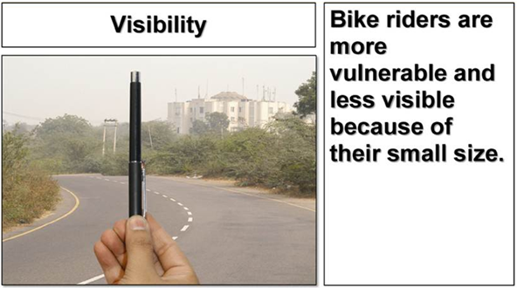
Safety Tips
Notes:
Riding a bike is quite different and much more difficult than driving a car in many aspects.
Motorcycles are not very stable.
A rider does not have any supplementary safety device apart from helmet whereas in a four wheeler the driver is covered from all sides sitting inside the cabin with safety device like seatbelt, airbags, ABS etc. ...
Thus a second of carelessness can lead to loss of balance or traction which results in critical and dangerous situations like crashes. 80% of accidents with bikes results in serious injuries or deaths.

Slide 21
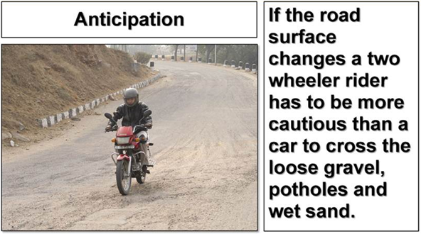
Safety Tips
Notes:
Defensive riding is all about anticipating and showing your presence on the road to others by looking well ahead, acting in time, keeping correct position, choosing appropriate lane through traffic, using good skills and exercising better techniques while manoeuvring.

Slide 22
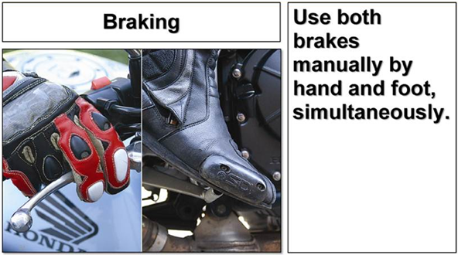
Safety Tips
Notes:
During braking, for a car it is just pressing the brake pedal which is evenly operated to all the wheels, where as in a two wheeler both brakes have to be operated manually by hand and foot and if the combination of pressure is not correct then it is dangerous.

Slide 23
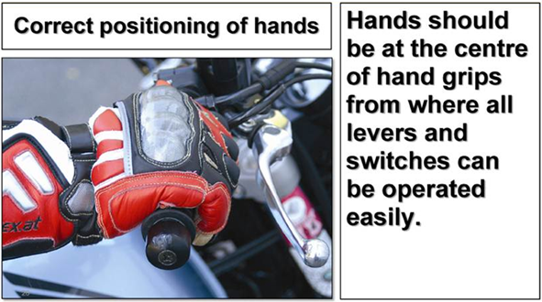
Safety Tips
Notes:
Park the bike on centre stand.
Stand on the foot rest on the motor cycle by holding the handle with both the hands, look forward and slowly sit down with full body weight on the feet and sit down. Practice this procedure till familiarised.
After holding handle, the position of elbows should be at 120° approximately.

Slide 24
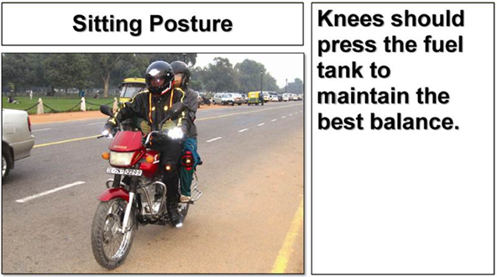
Safety Tips
Notes:
Sit comfortably.
Position of hips – sitting in a position where you can easily operate the handle- bar and brakes.
Have relaxed shoulders (take deep breath and release).

Slide 25
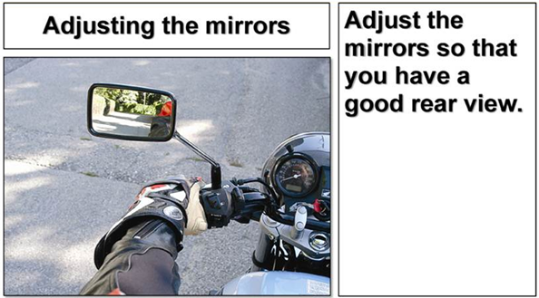
Safety Tips
Notes:
Adjust the mirrors until the tip of your shoulder can be seen in the lower edge of the mirror. Do not adjust the mirror while the motorcycle is on the main stand.

Slide 26
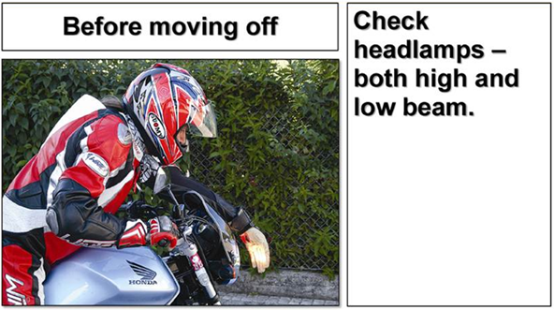
Safety Tips
Notes:
Turn on the following lights to check that all are working; - Head lamp - Hazard warning light - Turn signals - Tail lamp - Brake lamp
Keep headlight always “ON” while riding to be visible.

Slide 27
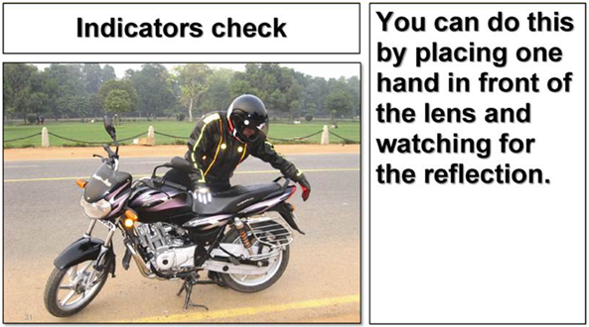
Safety Tips
Notes:
You should check serviceability of front and back, left and right indicators.

Slide 28
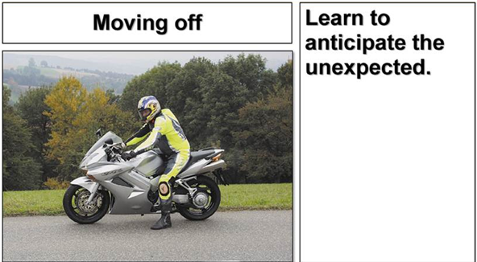
Safety Tips
Notes:
Look all around, to see if road is free.
Remove side/centre stand.
Give both hand signal and indicator.
Move feet and apply brakes for function check.
When safe, move off.

Slide 29
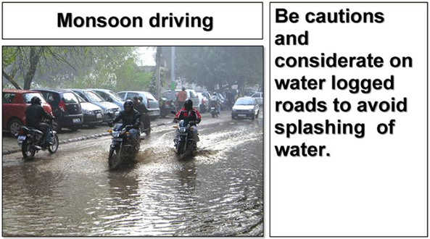
Safety Tips
Notes:
For two wheelers this situation is more dangerous than for four wheelers. Try to judge the path by looking at other vehicles movements ahead of you.
Move in first gear keeping sufficient following distance.
Give more accelerator.
Hold the handle firmly.
Avoid the extreme left of the road where there could be potholes or an open manhole.

Slide 30
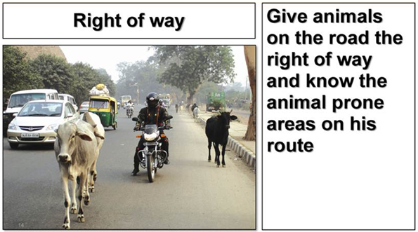
Safety Tips
Notes:
The awareness of social responsibility will develop a good healthy attitude that will help in being patient, considerate and careful about the safety of other people on the road and things which are shared by the masses. A rider also has a responsibility towards the environment and economy.
Knowing other road users behaviour will make you considerate towards them and avoid mishaps.
Understanding that everyone on the road has to perform their own work and use the road as they know it best. It is for the rider to understand the errors of others to make himself a safe rider.

Slide 31
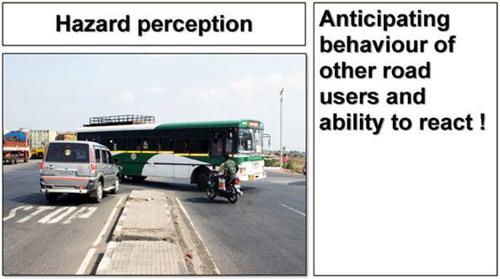
Safety Tips
Notes:
Take quick decisions during difficult and dangerous situations.
Be alert and develop the ability to predict and anticipate other road users behaviour.
This can save lives in an emergency situation.

Slide 32
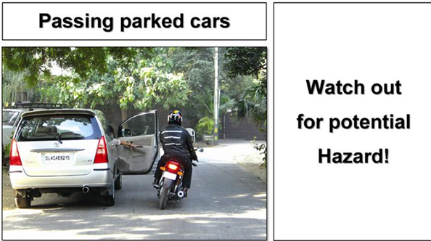
Safety Tips
Notes:
Stay towards the right of your lane while passing parked cars, to avoid problems caused by doors opening, drivers getting out of cars, or people walking from in between parked cars.

Slide 33
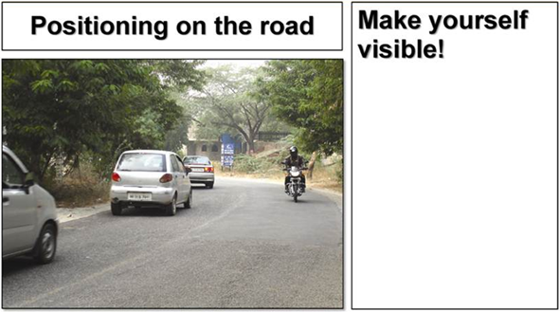
Safety Tips
Notes:
Keep left.
Keep a position where others can see you.
Keep changing position safely as per the changes of situations on the road.
On turns position yourself away from the turning line of other vehicles to avoid rear end collisions or side impacts as others may not notice your presence.
Remember motorcycles are smaller and others may not see them in time.

Slide 34
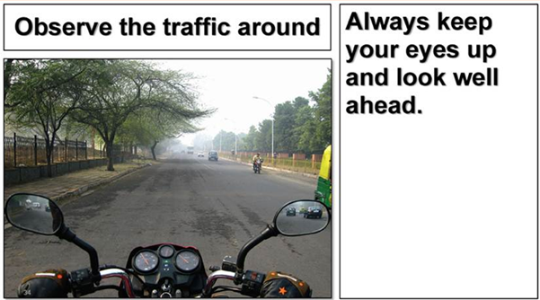
Safety Tips
Notes:
Looking in mirrors and over shoulders all around gives a clear view and allows you to take actions and to be visible and warns others of your intentions and presence.

Slide 35
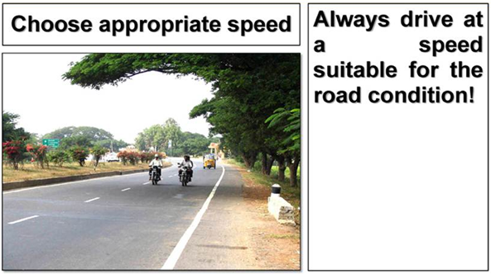
Safety Tips
Notes:
Slow down before every hazard spot. Always make a habit of slowing down bike six seconds before any hazardous spot. This avoids hard braking. Hard braking may cause a skid and a fall.

Slide 36
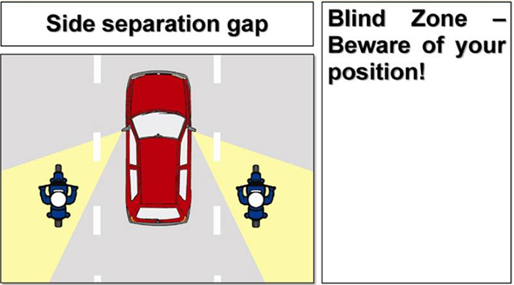
Safety Tips
Notes:
Keep a safety margin on at least one side to escape.
At turnings, constantly maintain the side gap as per the turning angle of other vehicles at both sides. If this is not sufficient, then pull back and utilize the safety margin.
Never ride closer than three feet to a long vehicle; like lorries and buses even at very slow speeds as they take a long time and distance to move away.
At traffic light signals stop behind the vehicle. Never pass between them through to go in front.

Slide 37
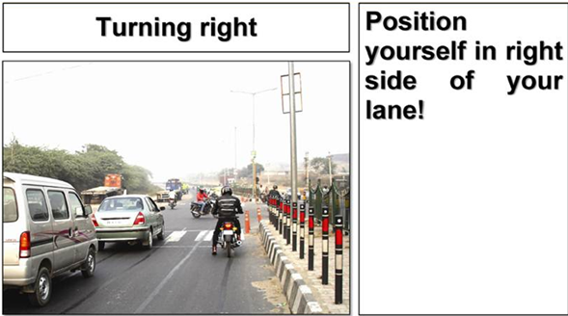
Safety Tips
Notes:
Show the appropriate signal to indicate your intention clearly.
Beware of pedestrians.
Observe all directions.
Manoeuvre and join on the left side of the road after turning right.

Slide 38
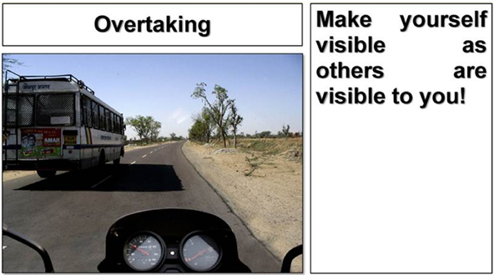
Safety Tips
Notes:
Overtaking
Ride on the right side of your lane at a safe following distance to increase your vision ahead and make yourself visible.
Watch out for oncoming and rear traffic.
If safe, indicate, move to the right lane and accelerate and overtake the vehicle in front.
Indicate again after a safety check and come back to your original lane after turning on your left indicator.
Always overtake within the local speed limits, and only where permitted.

Slide 39
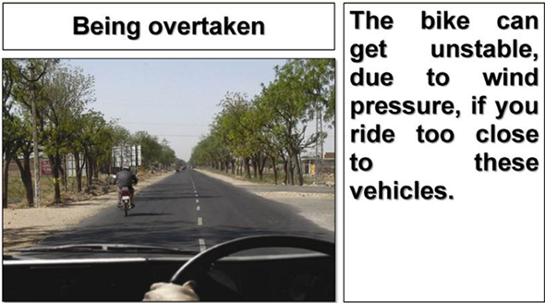
Safety Tips
Notes:
When you are being overtaken from behind or oncoming vehicle passes you, stay in the centre of your lane.
The bike can get unstable, due to wind blasts, if you ride too close to these vehicles.

Slide 40
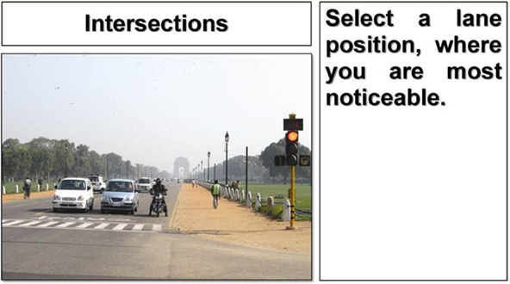
Safety Tips
Notes:
Two wheeler riders are less noticeable at intersections, which causes great conflict with the traffic.
Maintain a enough space around the bike to take evasive action in time.
Slow down and do not change your position radically.
Obey traffic signs and signals.
Give right of way, when it is required.

Slide 41
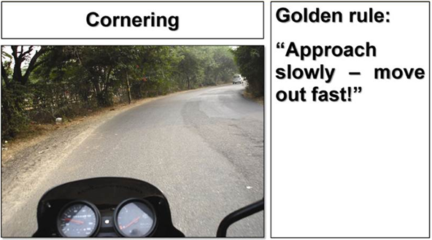
Safety Tips
Notes:
At all times apply this golden rule to the following steps:
Select an appropriate speed and go as wide as you can, without cutting lanes, to look around the corner.

Slide 42
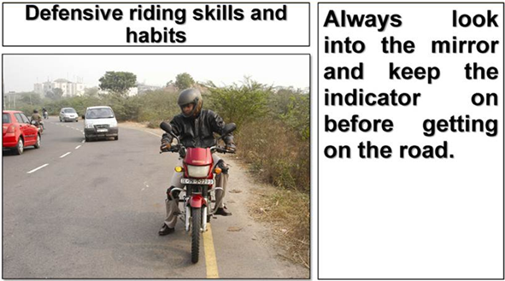
Safety Tips
Notes:
It is always good to keep the indicator on as a backup in case the human mind fails to respond and check through the mirror.

Slide 43
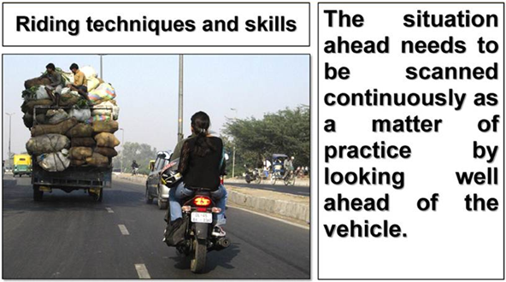
Safety Tips
Notes:
Some conditions become very difficult and potentially dangerous due to sudden change in road, weather and traffic conditions therefore one must always look well ahead to have sufficient time to react to situations.

Slide 44
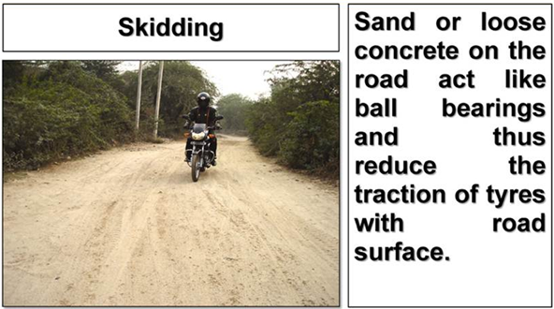
Safety Tips
Notes:
It is advisable to reduce speed well in advance so that sharp turning, acceleration, or braking that could cause skidding can be avoided.
Dust storms in rural areas can cause the road to become sandy or muddy which creates hazardous condition for tractors, carts etc.
Slow down, apply brakes and release them just before you reach the patch, hold the steering handle firmly, press the clutch, release the accelerator and keep the bike in straight ahead position.

Slide 45
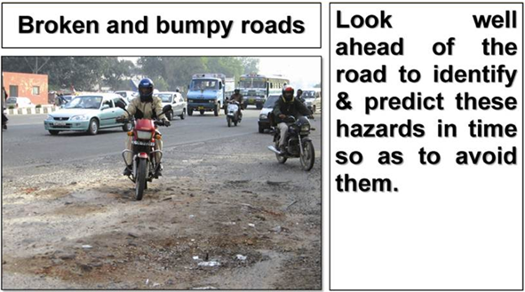
Safety Tips
Notes:
Edges of single narrow roads in rural areas can be washed away by rain water causing big potholes and they are barely visible under the road side hedges.
Release accelerator.
Apply as much pressure on the brakes as possible, but without skidding.
Release brakes and press the clutch just before the potholes/broken and bumpy roads to allow wheels to steer away from them or allow the suspension to be stable.

Slide 46
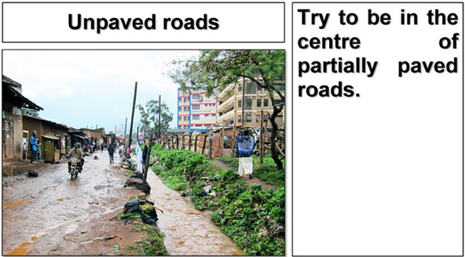
Safety Tips
Notes:
Try to use the hard path made by tyres of other vehicles or pedestrians to have a better traction.
Manoeuvre with low speed.
Never accelerate.
If you have to go for a long ride on such sandy/muddy roads, decrease air pressure to get a better grip.

Slide 47
Guidance while using public transport
Avoid sitting on the front / rear seat of the vehicle.
Stay alert during the entire journey.
Do not board / alight a moving vehicle.
Do not board the overcrowded auto rickshaw/ public transport.

